Slide 1
What About the California Wholesale Market Really Needs Fixing?
August 24, 2000

Slide 2
Summary
High prices in peak periods are the result of scarcity and are necessary to incent needed generation investment
California Retail/Wholesale Market Interaction
  Retail customers are benefiting from the low prices during shoulder months caused by wholesale competition
  The major problem is in the retail market where high peak period wholesale prices have not been mitigated by forward purchases
  Underscheduling in forward market causes high demand and reliability problems during real time

Slide 3
Summary (Continued)
Some wholesale market remedies are necessary now
  The FERC should analyze whether there are Market Power Concerns Associated with Times of Scarcity and then determine appropriate level of Price Caps
  Publicize Market Information
  Encourage structure/ technological innovation to enhance demand side participation

Slide 4
Agenda
Supply and demand data showing scarcity
Current supply/demand economics
Background - ISO and PX market structure
Regulatory overlay
Explanation of retail market problems
Wholesale market issues requiring staff investigation
Recommendations

Slide 5
Western Supply and Demand Fundamentals

Slide 6
Western Supply and Demand Indicates Scarcity
California competes vigorously with the rest of the growing west for increasingly scarce supplies
Load growth fueled by strong economy
No significant new generation in California since the 1980s
Market was fooled by excellent hydro years
The existing thermal generation fleet is aging: 61% > 30 years
The complete lack of available NOx credits may have prevented generators from running

Slide 7
California Competes with the Rest of the West for Scarce Supplies
Ample long distance transmission
Traditional Northwest players’ best opportunities often outside of the NW
  Powerex Accesses Alberta Pool, Northwest, California
  BPA often prices daily offer at PX Index price
  Spread between COB and Northern California close to $0/MWh
Turbine market is national --> Northwest and California must compete with all of North America for new resources

Slide 8
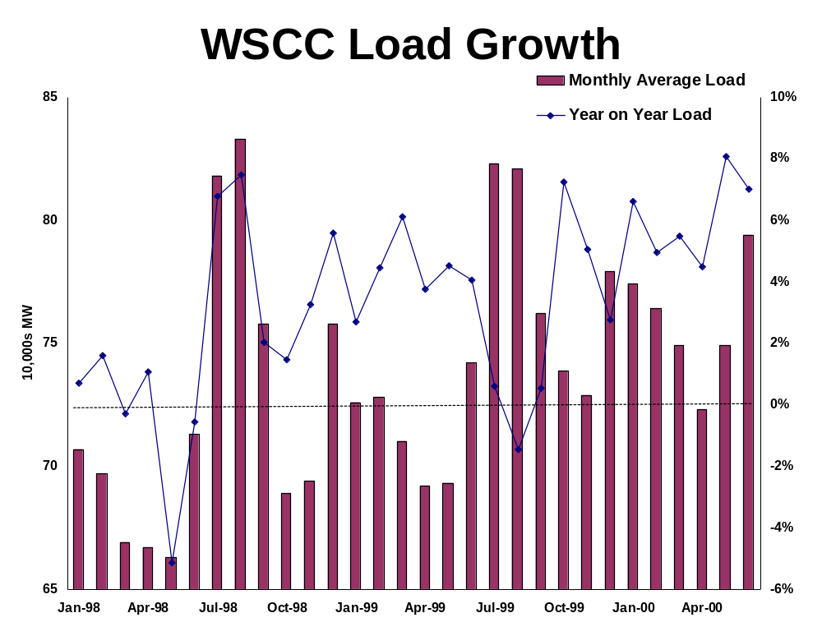

Slide 9
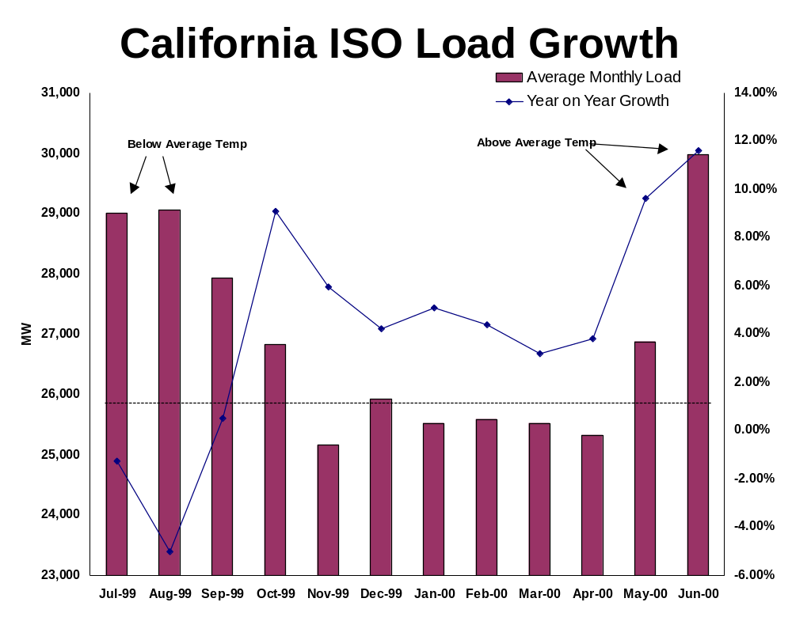

Slide 10
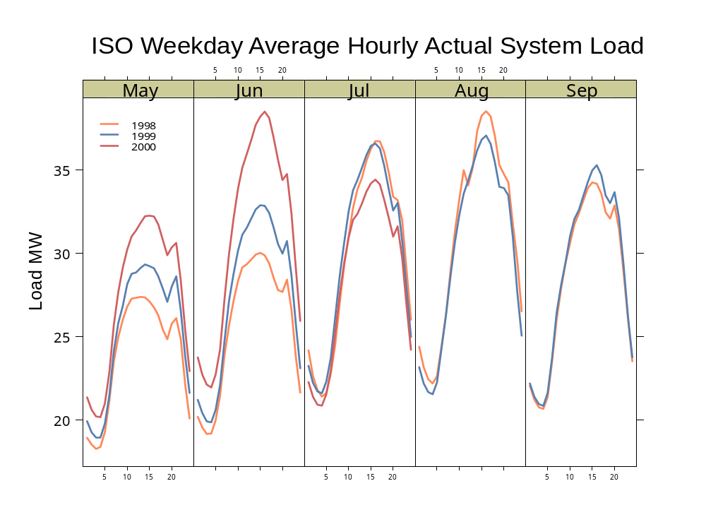

Slide 11
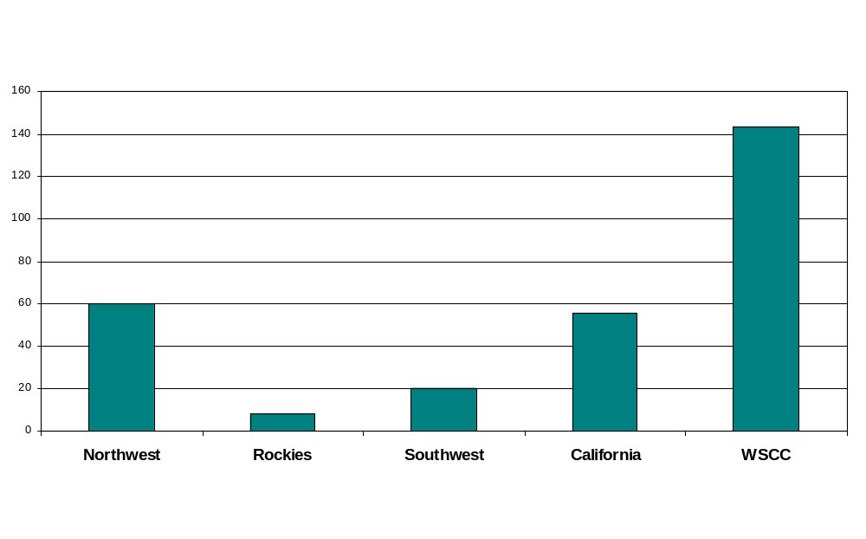
WSCC Loads (GW)
California is not an island and cannot develop a self-contained solution.

Slide 12
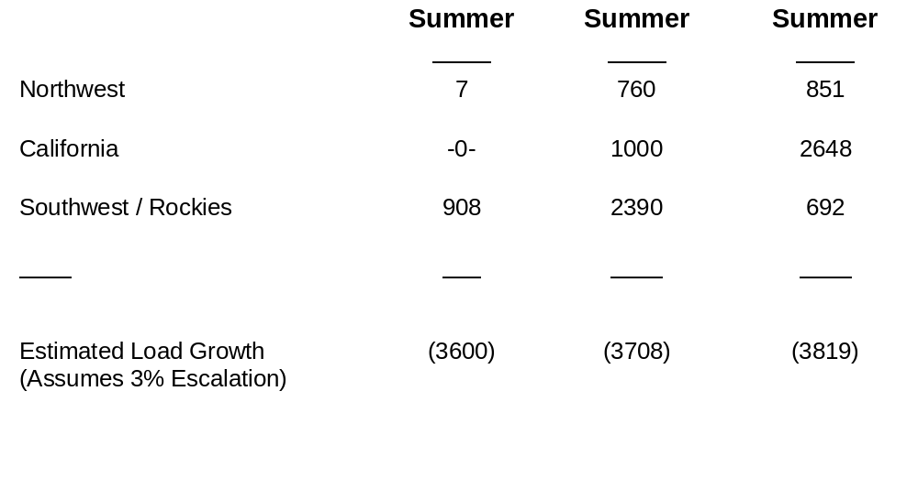
WSCC Capacity Additions

Slide 13
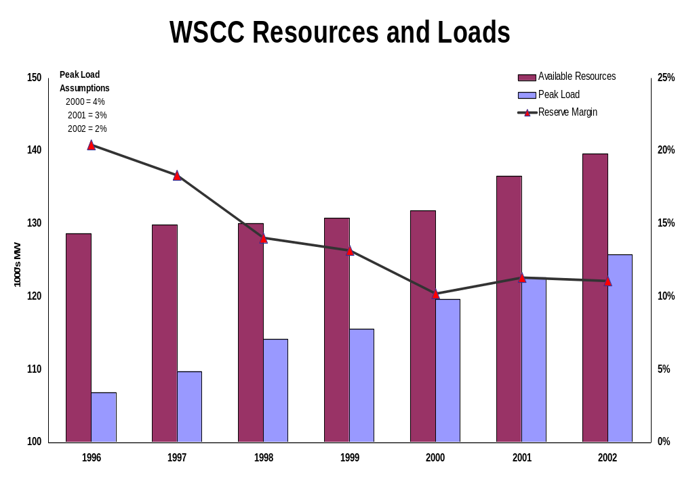

Slide 14
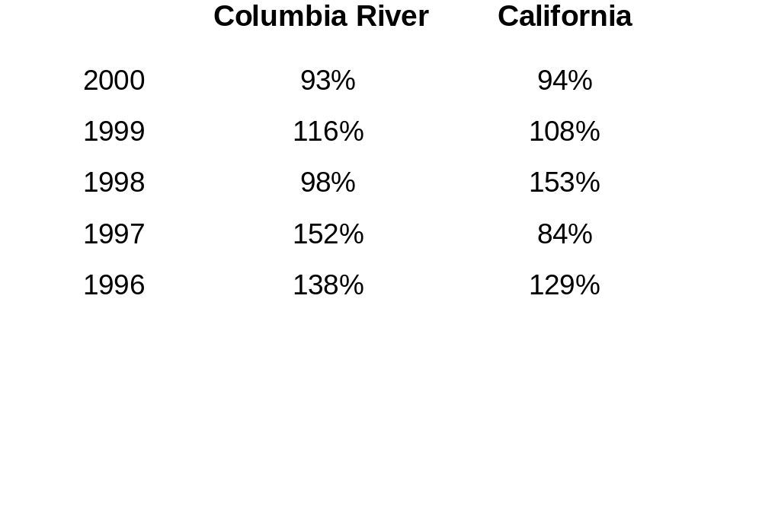
Has Recent Unusually Strong Hydro Fooled Us?
Volume Runoff Percent of Normal

Slide 15
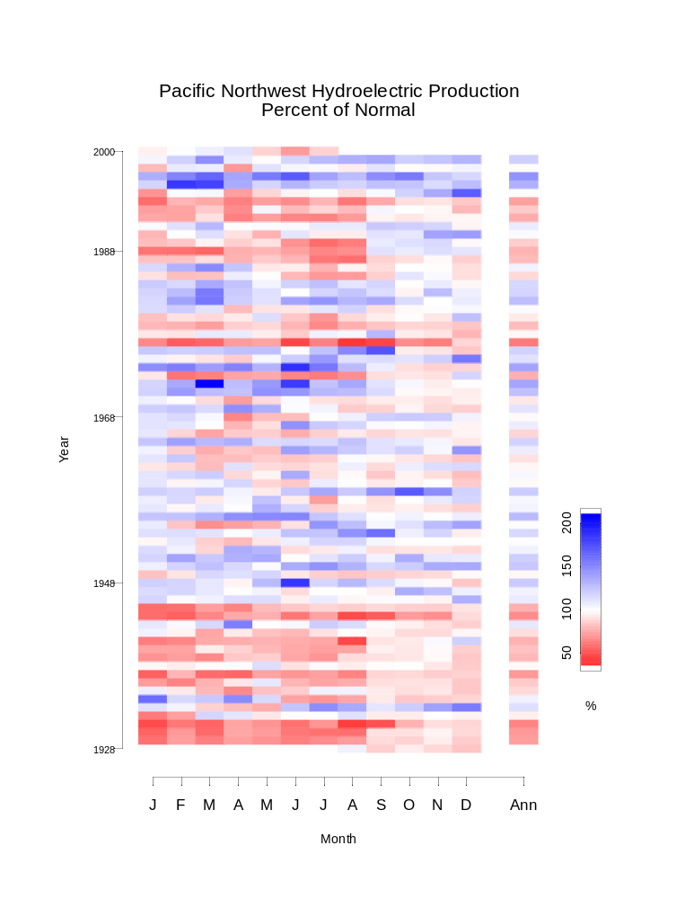

Slide 16
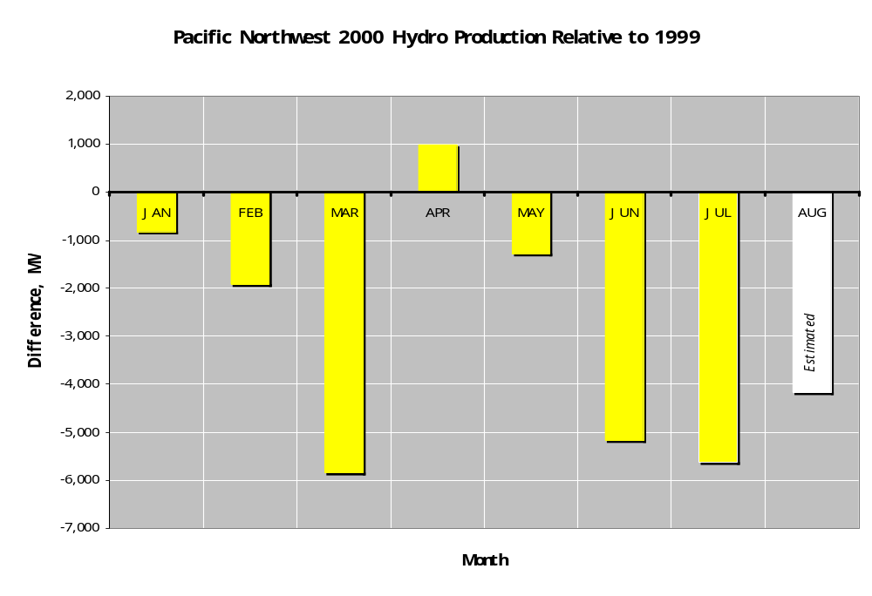

Slide 17
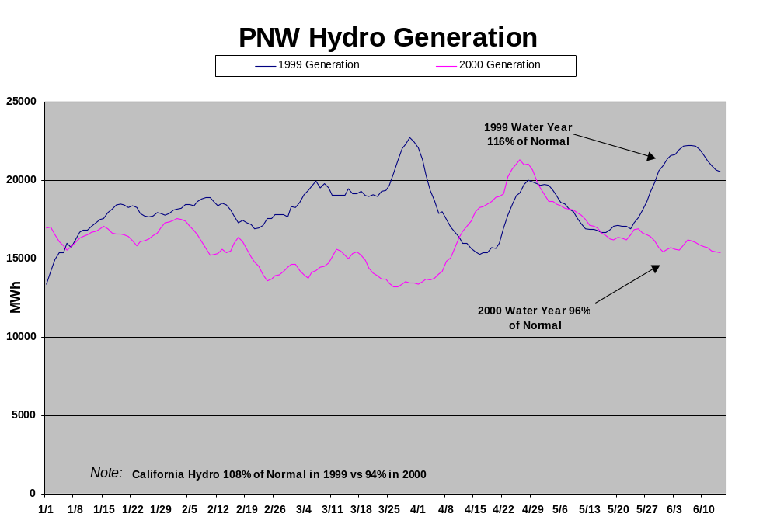

Slide 18
In Sum, Scarcity is Real - Generation is Needed
Scarcity is real
Energy prices driven by scarcity
New generation required

Slide 19
Current Supply/Demand Economics

Slide 20
FERC Regulatory Overlay
Allowed Cal ISO to set “bid” caps
  Price reduced from $250 to $750 on 10/1/99
  Reduced from $750 to $500 on 6/29/00
  Reduced from $500 to $250 on 8/7/00
Cal PX - recently reduced from $2500 implicit cap to $350 explicit cap

Slide 21
Price Controls Will Perpetuate Scarcity
Power plants are needed; Demand is still not very price responsive
Operating costs of plants are increasing
  Gas prices high
  Gas generally is on the Margin in WSCC (I.e., Gas-fired generation sets the electricity generating market price)
Power plant economics will keep generators from investing in generation if they anticipate price cap
In state and out of state generation will be incented to sell out of state

Slide 22
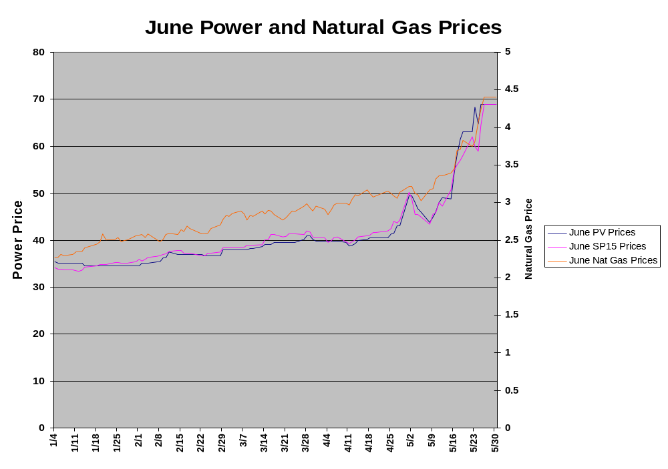

Slide 23
Power Plant Economics
Investors will not invest in power plants if they can only earn short term marginal cost (I.e., the cost of fuel and operation and maintenance without earning a return on their investments)
The $250 price cap may not provide a return on investment

Slide 24
Peaker Plant Economics
Technology: GE LM 6000
Fuel: Natural Gas
Heat Rate: 10,000 Btu/Kwh
Capacity: 48 MW
Capital Structure:
  60% Debt @ 9%
  40% Equity @ 18%
  15 Year Amortization
Total Cost to Build: $27 million
Annual Capital Recovery: $3.7 million
Annual Fixed O&M: $1.5 million
Annual Total: $5.2 million

Slide 25
Baseload Plant Economics
Technology: GE Frame 7FA Combined Cycle
Fuel: Natural Gas
Heat Rate: 7,100 Btu/Kwh
Capacity: 280 MW
Capital Structure:
  50% Debt @ 9%
  50% Equity @ 15%
  15 Year Amortization
Total Cost to Build: $180 million
Annual Capital Recovery: 24 million
Annual Fixed O&M: 3 million
Annual Total: $27 million

Slide 26
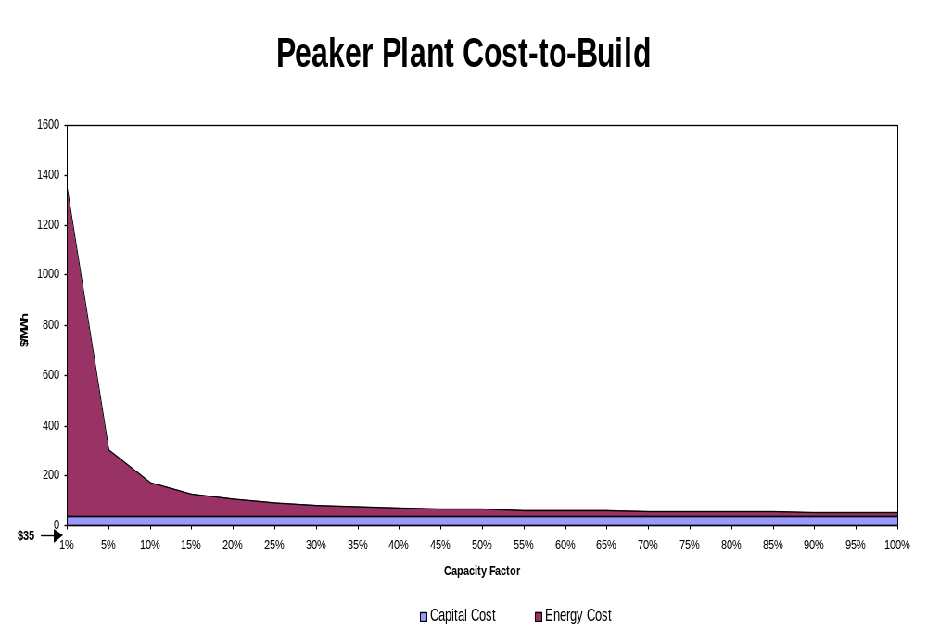

Slide 27
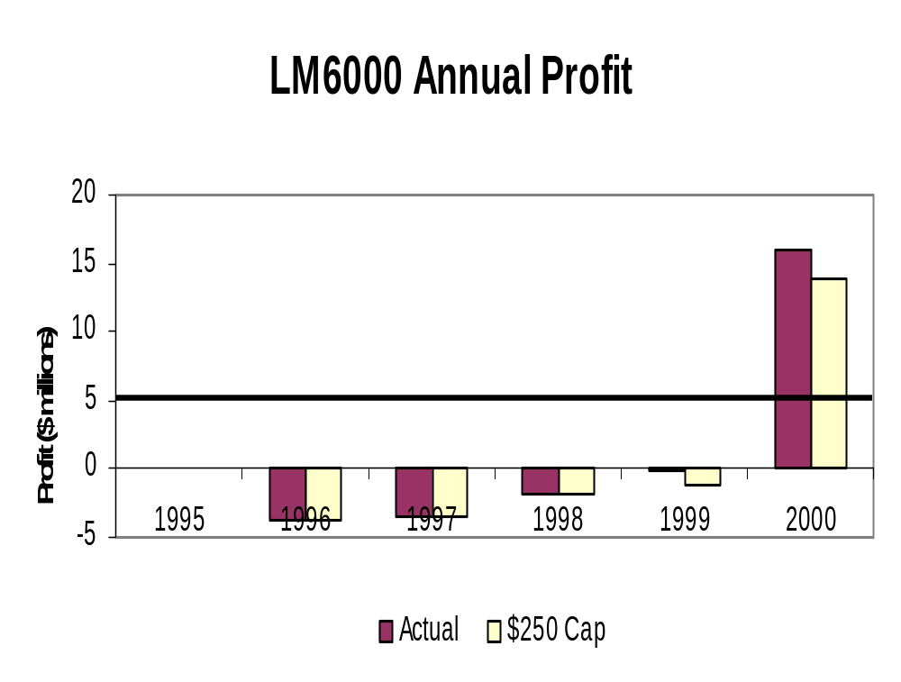
18% ROE

Slide 28
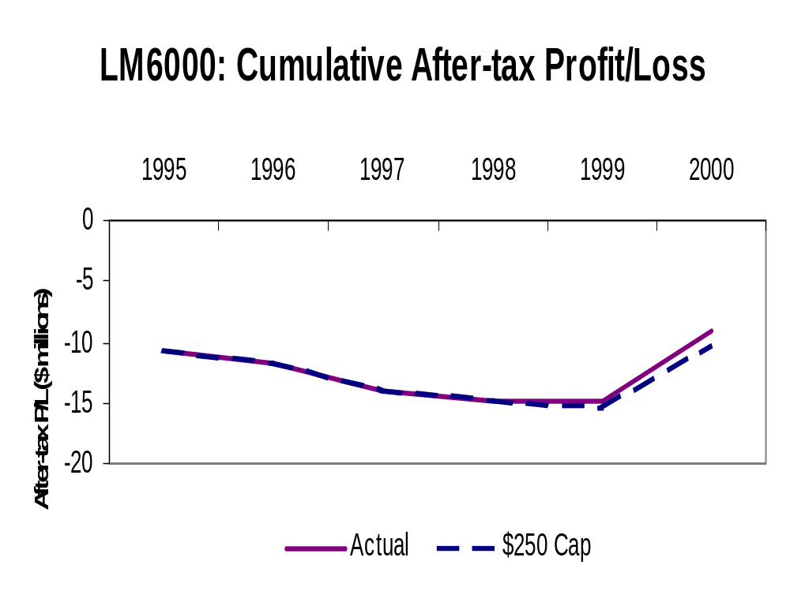

Slide 29
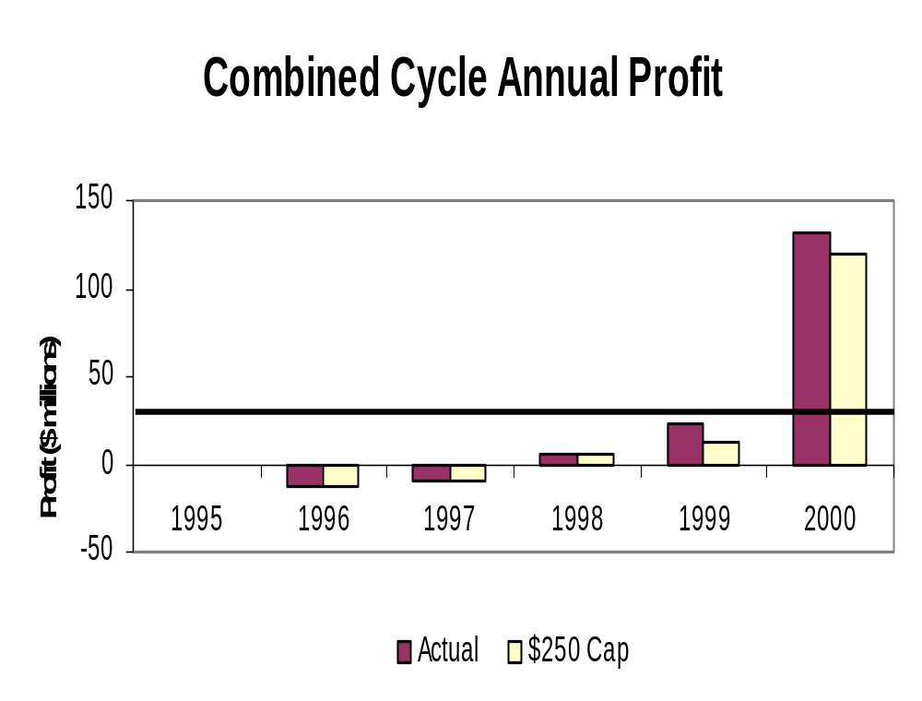
15% ROE

Slide 30
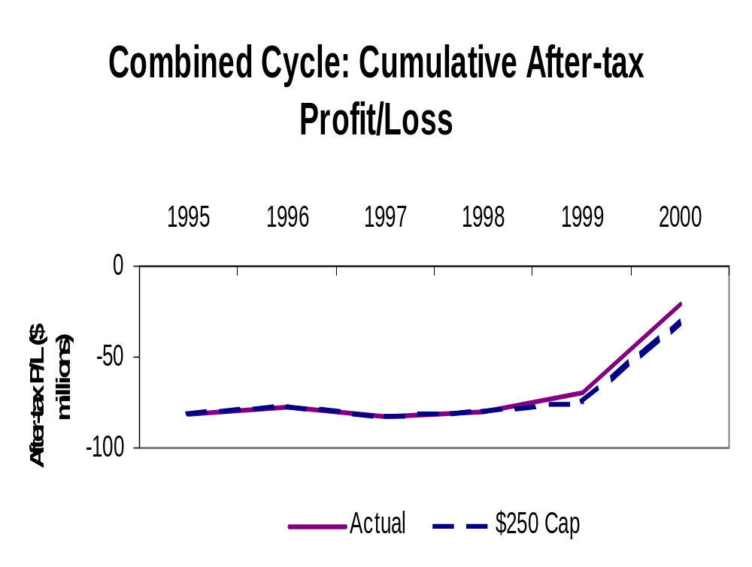

Slide 31
Load Responsiveness
2700 MW of Load theoretically available under the Interruptible Tariffs
New Load Management Programs Have Been Expensive and Small
  100 MW to 300 MW of Shared Savings with IOU’s When Prices Exceed $250/MWh
  230 MW in CAISO Participating Load Agreement with Capacity Costs of $750/MWh and Energy Costs Up to $750/MWh
  Seldom Used - Most Participants Already Under Interruptible Tariff

Slide 32
The ISO’s Demand Side Program Has Not Been Very Effective
The proponents of price caps claim that as soon as the demand side is "workably competitive" then there is no need for price caps
But if ISO sets the caps too low it will not get demand response
The utilities have up to 2700 MW of available interruptible load, yet only a small fraction responds when called (600 MW)
Uncut loads willingly lose value of up to $1,500 per MWh
Thus, during times of scarcity, the value of energy is at least $1,500 per MWh

Slide 33
Price Controls are Detrimental to Investment and Other Markets
Merchant generation subject to volatile commodity prices -- caps will inhibit investment
Creates asymmetry between load response and generation
Suppliers will sell outside California where markets are more predictable and prices are higher.
Because of the interdependent linkages in California’s electric market, cannot change one aspect of structure without impacting all others
Uncertainty in the marketplace will dry up the growing forward markets

Slide 34
Background
ISO and PX Market

Slide 35
California Independent System Operator
Real Time Energy Market - Based on complex computer model
Day ahead and hour ahead ancillary service market
Day ahead and hour ahead transmission market

Slide 36


Linkages in California’s Electric Markets
ISO
A/S
A/S
Capacity $
Capacity $
MWh
MWh
Ex Post Price
Ex Post Price
Load
Generation

Slide 37
California Power Exchange
Day Ahead Energy Market - Single price auction based on cross of supply and demand bids.
IOUs all energy purchased from this market deemed “prudent” by PUC.

Slide 38

Linkages in California’s Electric Markets
ISO
A/S
A/S
Capacity $
Capacity $
MWh
MWh
Ex Post Price
Ex Post Price
Load
D.A. PX Index
PX Day Ahead
D.A. PX Index
Generation
MWh
MWh

Slide 39

Linkages in California’s Electric Markets
ISO
A/S
A/S
Capacity $
Capacity $
MWh
MWh
Ex Post Price
Ex Post Price
Load
D.A. PX Index
PX Day Ahead
D.A. PX Index
Generation
MWh
MWh
Fixed Price
Fixed Price
MWh
PX Block Forward
MWh

Slide 40

Linkages in California’s Electric Markets
ISO
A/S
A/S
Capacity $
Capacity $
MWh
MWh
Ex Post Price
Ex Post Price
Load
D.A. PX Index
PX Day Ahead
D.A. PX Index
Generation
MWh
MWh
Fixed Price
Fixed Price
MWh
PX Block Forward
MWh
Negotiated Price
Negotiated Price
MWh
Non CAISO MARKET
MWh

Slide 41
California Regulatory Overlay
Assembly Bill 1890
  Provided mechanism for recovery of stranded costs.
  Required divestiture of thermal generating resources.
  Froze IOU retail rates until either April of 2002 or stranded costs are recovered, whichever is sooner.

Slide 42
Recent California Events
CPUC limits on hedging in the “forward” (longer term) market
8/03/00 CPUC allowed PG&E and SoCal Edison to do bilateral deals in forward market (subject to previously established hedging limits) if PX schedules the deal
CPUC performs expedited, upfront prudence review
CPUC considering similar proposal by SDG&E

Slide 43
Retail/Wholesale
Market Interaction

Slide 44
Are Retail Prices High and Do They Indicate Wholesale Market Failures?
DMA admits that there is workable competition for 98-99% of the total annual hours
It assumes that market power is present when bids exceed only short run marginal cost rather than considering long term returns, or other market power indices.

Slide 45
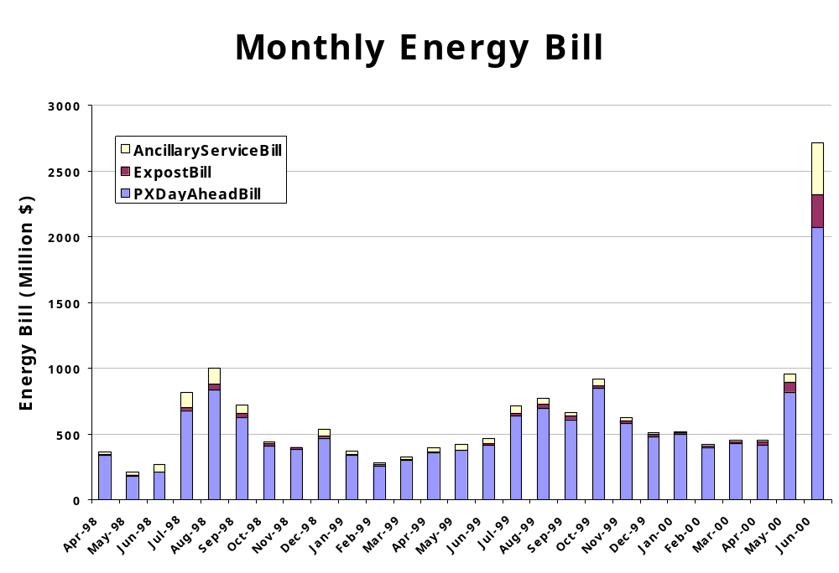
-15-

Slide 46
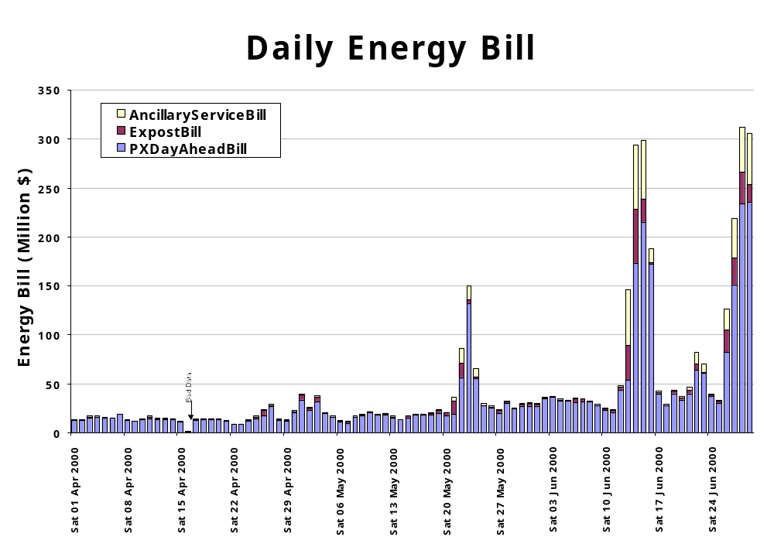
-16-

Slide 47
Do these Prices Warrant Wholesale Market Intervention?
Overall, even with scarcity conditions, retail prices have not been significantly increased due to wholesale competition in California (for SDG&E 10-20 percent annual increase, possible 10-20% overall decrease when adjusted for SDG&E rebate)
Is it appropriate to institute wholesale price controls to mitigate retail price risk?
Wholesale futures prices are behaving rationally regardless of these short term retail prices

Slide 48
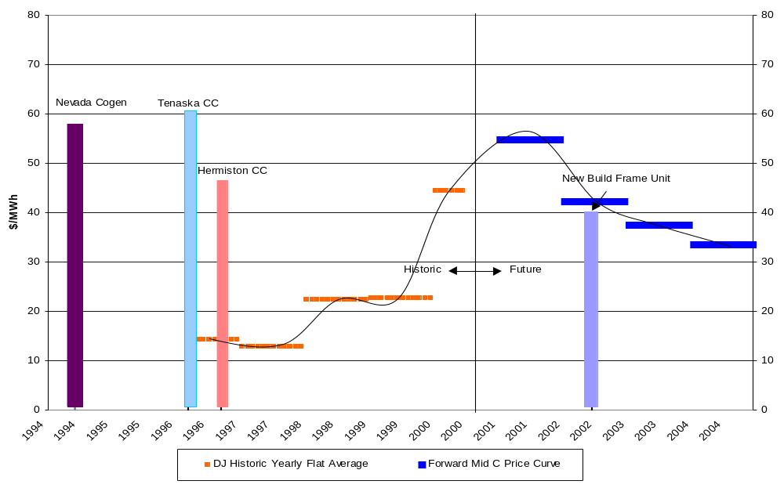
The Market Assumes That Wholesale Prices Are Decreasing with New Resource Additions

Slide 49
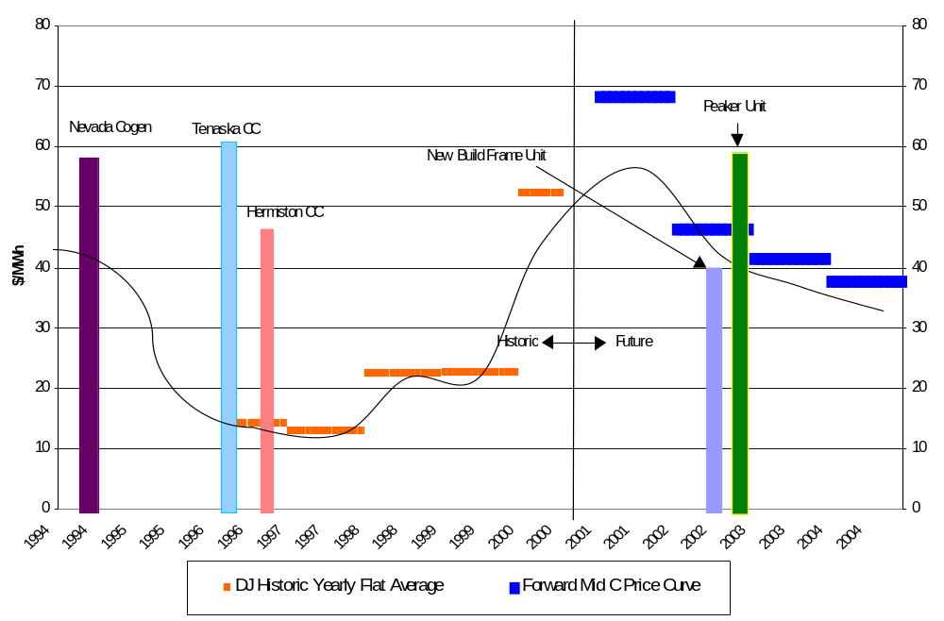
The Market Assumes That Wholesale Prices Are Decreasing with New Resource Additions
*Estimates for QF contract prices based on Lawrence Berkeley Laboratory Report published in 1996.

Slide 50
Lack of IOU Hedging Has Distorted Price Impacts
The IOUs had a choice of buying their power in the PX Block Forward, PX Day Ahead, PX Day Of, and CAISO Ex Post
Hedging limits prevented some purchases of forward energy
IOU claims notwithstanding, there have been significant opportunities to hedge forward prices
  ~ 1800 MW in entire PX block forward for SP15 in June, 2000
  Only ~800 MW for SCE out of 2,200 MW authorized
  Clear market signals to hedge
Fear of prudence review kept IOUs from hedging the risk of day ahead and real time prices

Slide 51
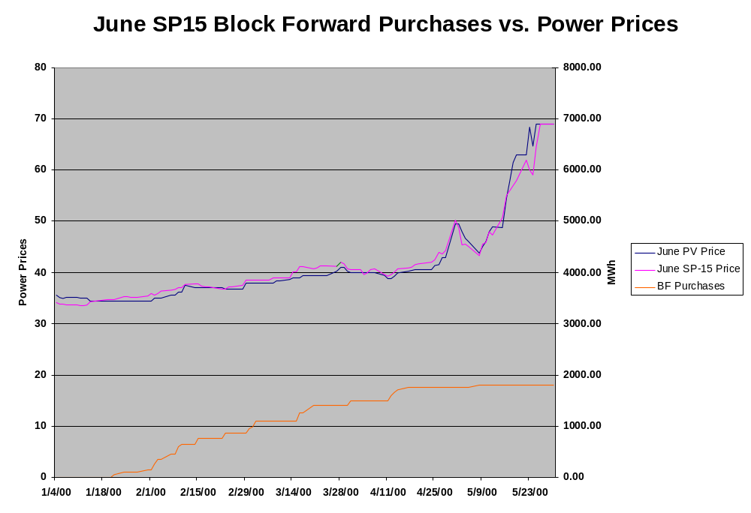

Slide 52
Stranded Cost Recovery Incents IOUs to Underschedule in the Forward Market and Buy in the Spot Market
CTC payments can theoretically be increased by underscheduling demand in the PX Day ahead markets
But, underscheduling demand increases ISO prices and reduces reliability
  ~ 30% of ISO load in real time market on 06/14/00
  Only 100 MW of blackouts--a remarkable achievement

Slide 53
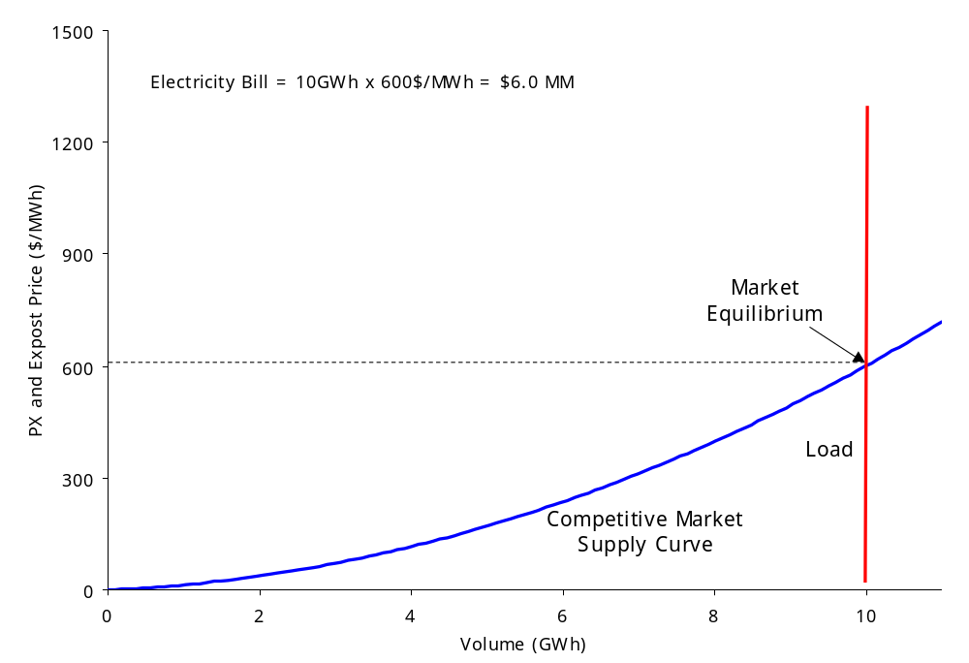
Gross Underscheduling of Load Is a Real Problem
If all power scheduled in PX Day Ahead market, except for small imbalances, market should be in equilibrium: PX DA, PX HA, ISO Ex Post

Slide 54
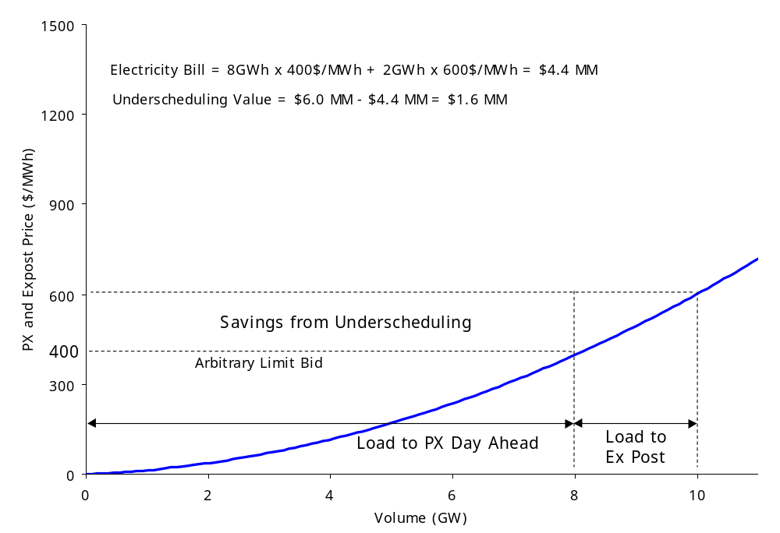
Gross Underscheduling of Load Is a Real Problem
In actual fact, there is an incentive to underschedule, but consequence is pressure on real time reliability as Ex Post load grows.

Slide 55
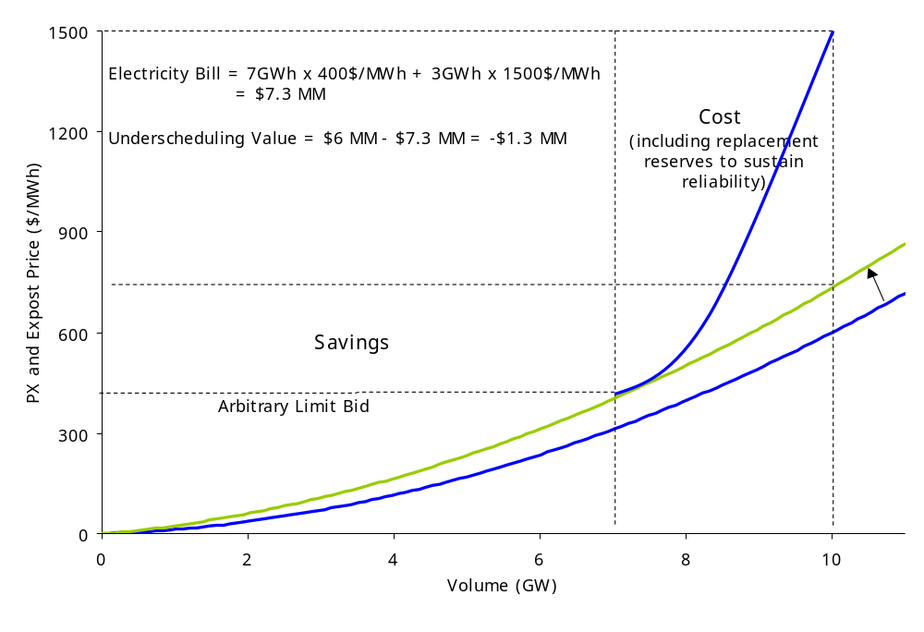
Gross Underscheduling of Load Is a Real Problem
But when there is massive underscheduling in a tight supply market, the ISO may have to take drastic action.
Increasing load
to Ex Post

Slide 56
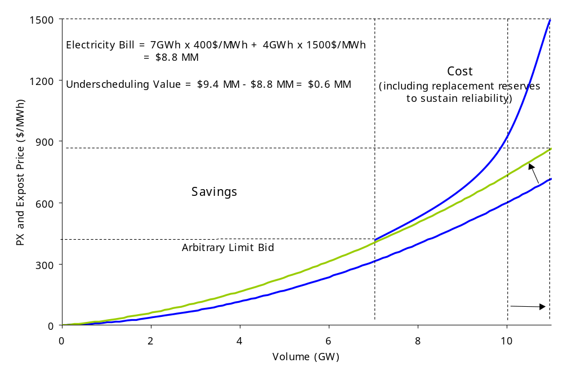
Gross Underscheduling of Load Is a Real Problem
And, when load is growing faster than forecasts, the consequences are amplified.
Increasing load
to Ex Post

Slide 57
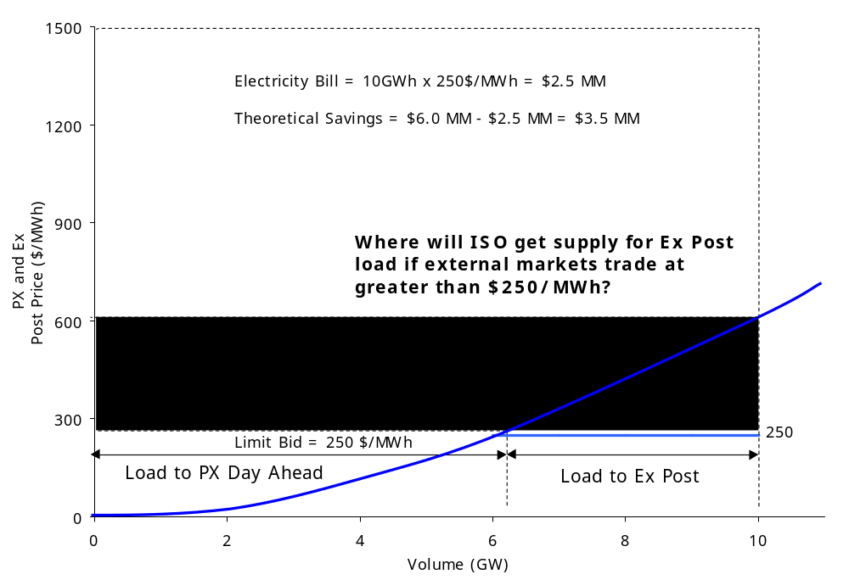
Gross Underscheduling of Load Is a Real Problem
When price caps are reduced to $250/MWh in a scarce supply market, ISO may not be able to maintain reliability due to magnitude of Ex Post load.

Slide 58
Underscheduling’s Effects on Reliability Are Observable
Stage 1 Emergency
  In Anticipation of Low Reserves
  Users Asked to Voluntarily Reduce Consumption
  15 Times From May 22 to August 5
Stage 2 Emergency
  Reserves Fall Below 5%
  2700 MW of Interruptible Load Curtailed
  9 Times From May 22 to August 5
Stage 3 Emergency
  Reserves Fall Below 1.5%
  Firm Load Cut - Rolling Blackouts
  0 Times From May 22 to August 5

Slide 59
Wholesale Market Remedies Necessary Now
Analyze whether there are market power concerns associated with times of scarcity and then determine appropriate level of price caps
Publicize market information
Encourage structure/ technological innovation to enhance demand side participation
Don’t mistake San Diego’s failure to hedge as failures in the wholesale market
Decide whether FERC has a role in the underscheduling issue: Are the California utilities exercising monopsony power by underscheduling load into the PX day ahead market?

Slide 60
ISO Should Do More Rigorous Market Power Analysis
The Market Analysis Unit report and the UC Energy Institute Report wrongly uses pricing above short term marginal cost to conclude that there is market power
Some market power analysis failed to take into consideration changes in supply and demand like the decrease in hydro generation
To distinguish market power from scarcity, FERC should instruct the ISO to use rigorous analytical measures to determine market power
Under such measures Enron does not have market power

Slide 61
ISO Should Allow Scarcity Rents
At points of scarcity (e.g., at Stage 2 when you’re getting low on reserves and you’re cutting load) marginal cost is no longer a reasonable price.
Rather when you reach scarcity you should price scarcity rents at the value of energy (e.g., $1,500 as illustrated in the interruptible market)

Slide 62
To Investigate the Source of High Prices FERC Should Review:
High gas prices
Below normal Hydro
Lack of NOx credits
High demand
How many MWs did the CA ISO procure during the Summer 2000 compared with 1999?
Has PG&E changed its bidding behavior associated with its Hydro facilities in 2000?
Were baseload facilities operated differently in 2000 than in 1999?

Slide 63
To Investigate the Source of High Prices FERC Should Review (Continued)
Were any generation plants off-line due to unplanned maintenance during Summer 2000?
Were other Western power markets prices higher (year-on-year)?
What options did SDG&E have to "hedge" its retail rates?
What were prices in the CAL PX block forward market on Jan 15, 2000 and May 15, 2000?
FERC and the ISO should consider the regional impacts of any price caps implemented in California, such as prices not corresponding to flows

Slide 64
Other Market Growing Pains
Only a limited number of out-of state participants can access spin and non-spin markets
Rate freeze prevents consumers from receiving price signals (I.e., some amount of load increase is illogical behavior)
Intrazonal congestion not explicitly priced--Socialized across all loads
Complex computer model used to price transmission
Relatively little transmission available in forward markets
Stakeholder board subject to political pressure
Forward market liquidity has evaporated due to price cap changes

Slide 65
We Do Not Have All the Answers. Why?
Much information that is necessary to analyze the California PX and ISO markets is not available to markets participants
We believe that California can significantly enhance competition in its electricity markets if this information is made available

Slide 66
Why Would Information Make the Market More Competitive?
Publishing price information would provide better price signals producing a more efficient market
Publishing generation and load information would remove competitive advantages held by monopsony load servers and generators with a large percentage of the market
Publishing transmission information would remove the ATC knowledge advantage retained by grandfathered transmission contract holders
More information would help the market to self-police

Slide 67
Generation and Load Information That Should be Available
"After the fact" actual meter information depicting actual unit-by-unit production and consumption within each zone.
Unit outage information showing planned and forced outages.
Water levels, or hydro outputs. Weekly/monthly information.
Data on significant unit outages etc. in the peak prices hours in question.
Calls by the ISO on plants with Reliability Must Run contracts.

Slide 68
Energy and Ancillary Service Price Information That Should be Available
All bid information in both Day Ahead and Hour Ahead Markets, including generation and load, energy and ancillary services
The information for these markets should include: initial preferred schedules, final schedules and the BEEP stack, all day ahead load and generation bids by Scheduling Coordinator

Slide 69
Transmission Information That Should be Available
The information should include adjustment bids, day ahead schedules, hour ahead schedules, real time adjustments, actual flows, and transmission availability by category of ownership
This information should be provided for all transmission lines
Significant Intra-zonal congestion by transmission path
Data should be differentiated by existing and new, firm use transmission contracts

Slide 70
When Should This Information Be Available?
The information listed above ought to be provided as close to "real time" as possible.
At a minimum it ought to be provided to the market within 24 hours.

